Slide 1
Transformer XAI

Slide 2
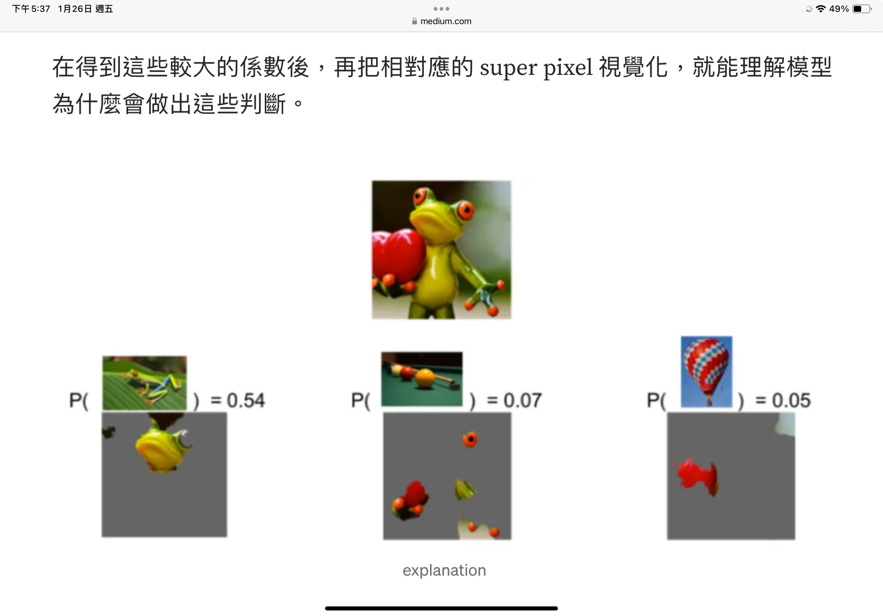
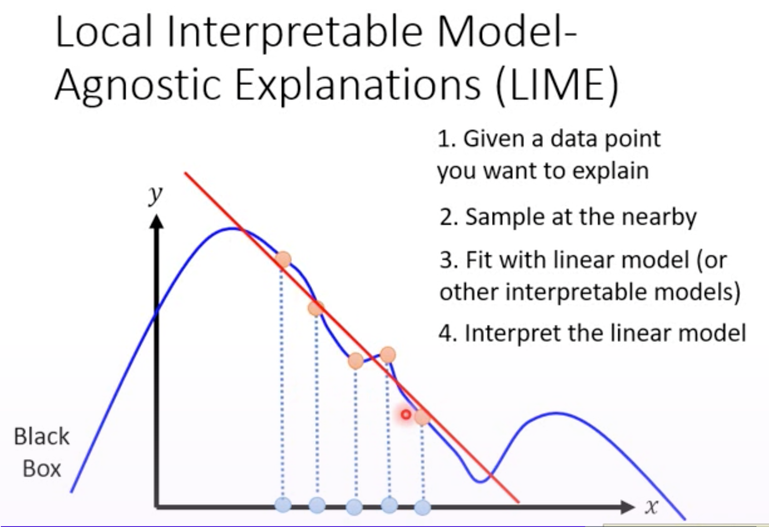
LIME (Local Interpretable Model Agnostic Explanations)
Ribeiro, M.T., Singh, S., Guestrin, C.: Why should I trust you?: explaining the predictions of any classifier. In: 22nd ACM SIGKDD International Conference on Knowledge Discovery and Data Mining (KDD 2016), pp. 1135–1144. ACM (2016)
Main concept: use surrogate model (easy to explain) to explain main model (hard to explain) - indirectly
Pros: No need of model’s internals
Cons:
(1) large computational costs
(2) the quality of the explanation largely depends on the quality of the surrogate fit
(3) Sampling may result in variable explanations for the same input sample
(4) single instance focus
Process: Choose an img X -> sample data points around [X']-> main model (e.g. CNN) -> y -> simple model (e.g regression) fit X’, y
GraphLIME
Main concept: GNNExplainer, not linear LIME -> Using HSIC Lasso model (a non-linear interpretable model = feature selection method considering the nonlinear input and output relationship) to explain the main model
Pros: GNN model-agnostic
Cons: For GNN only

Slide 3
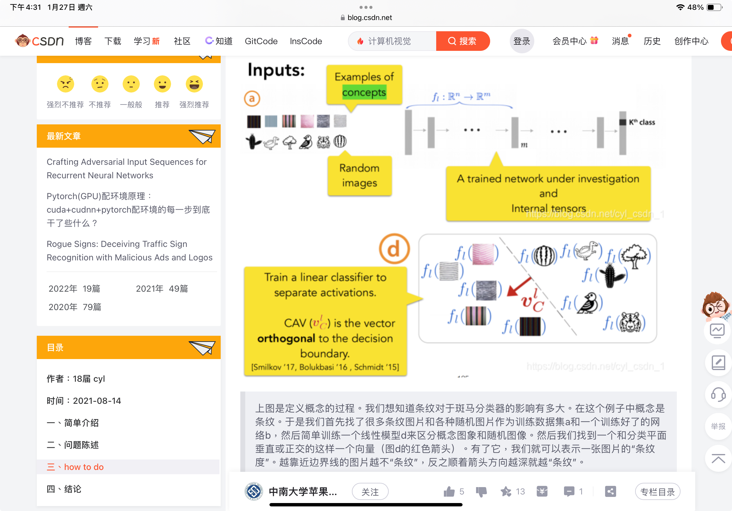
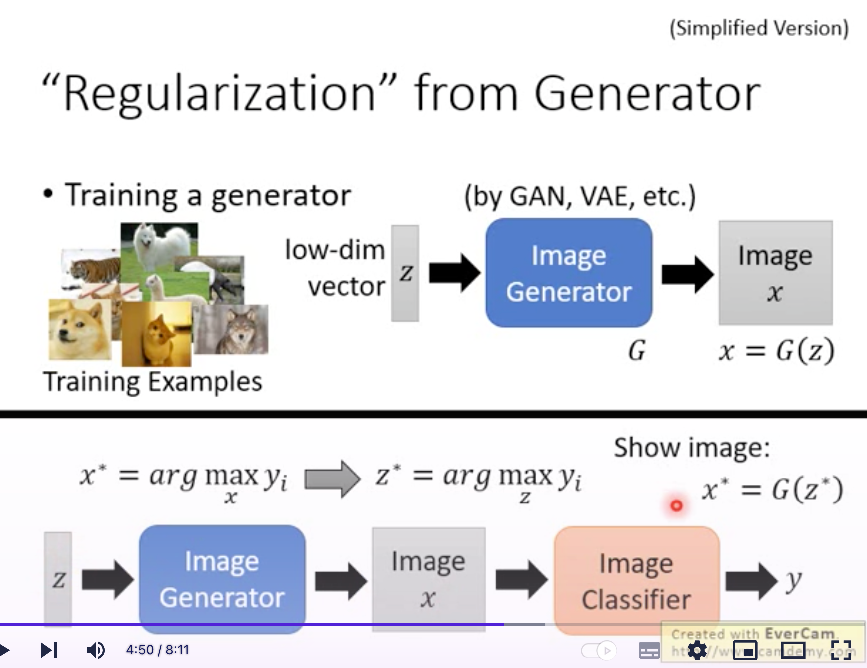
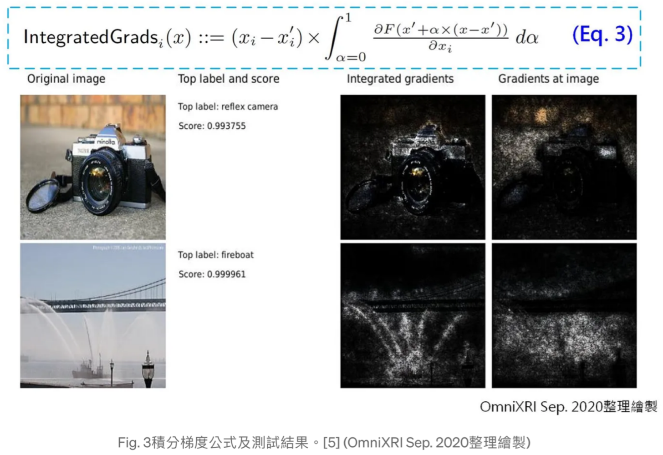
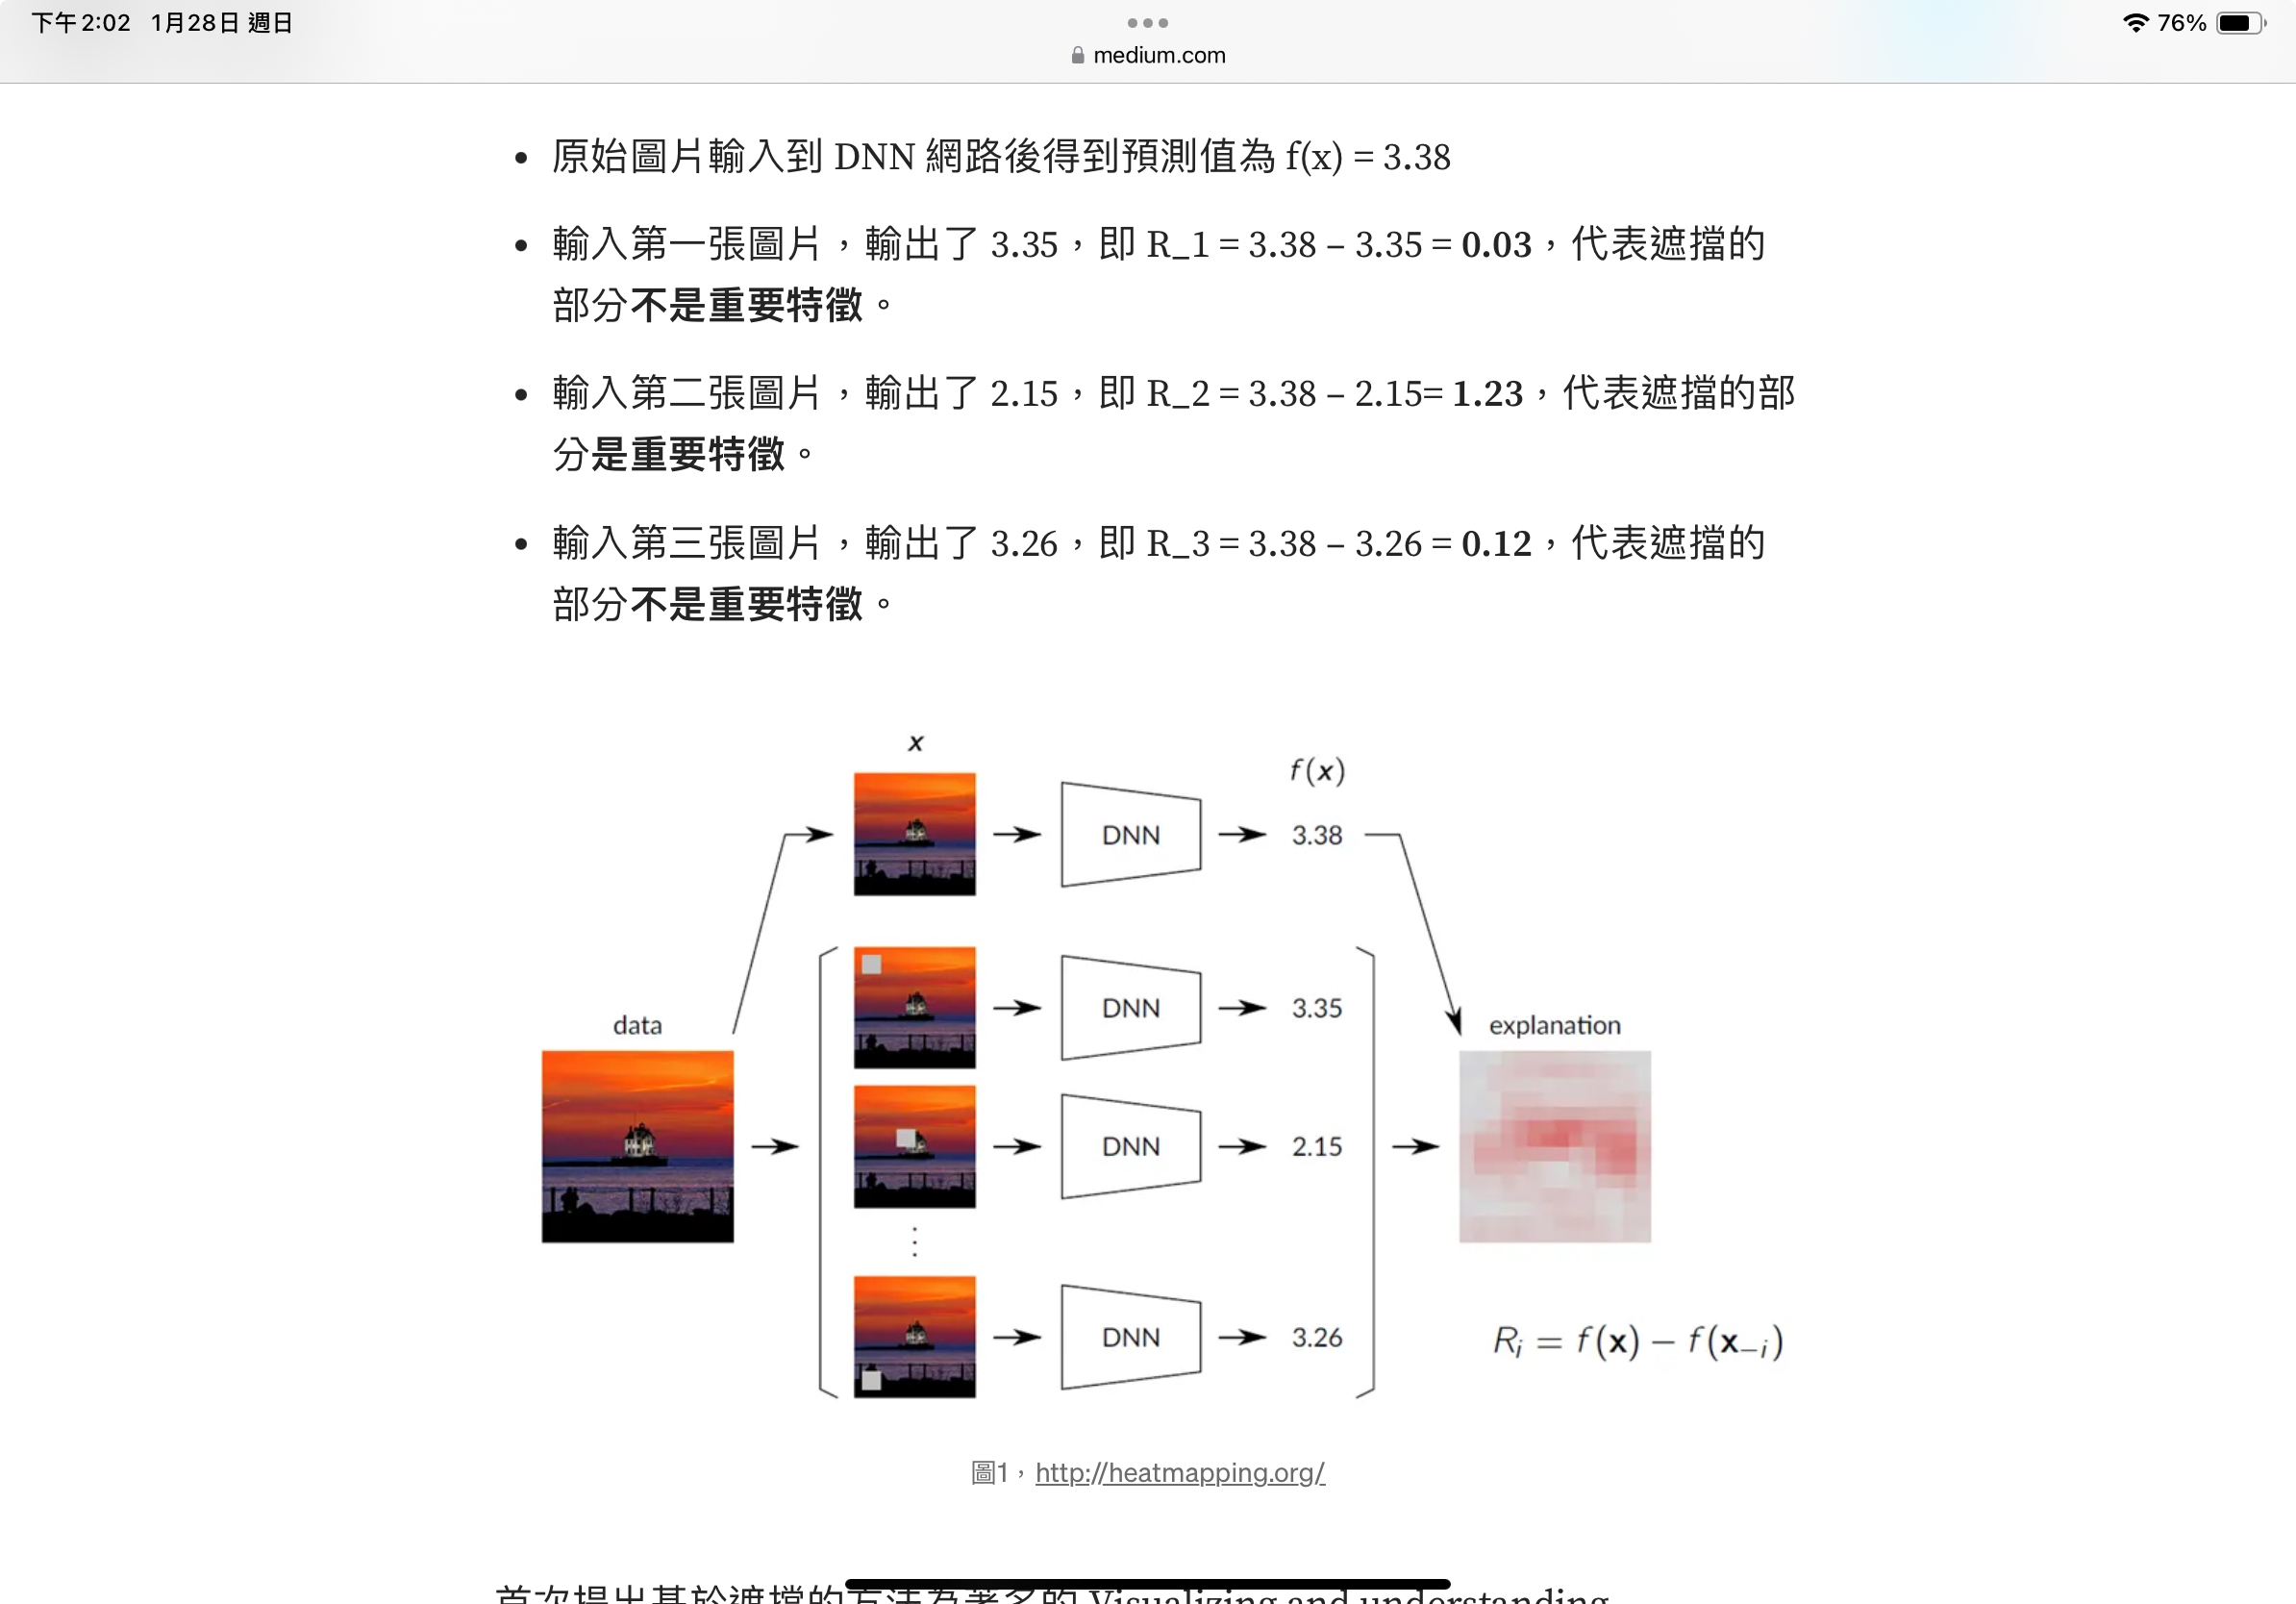
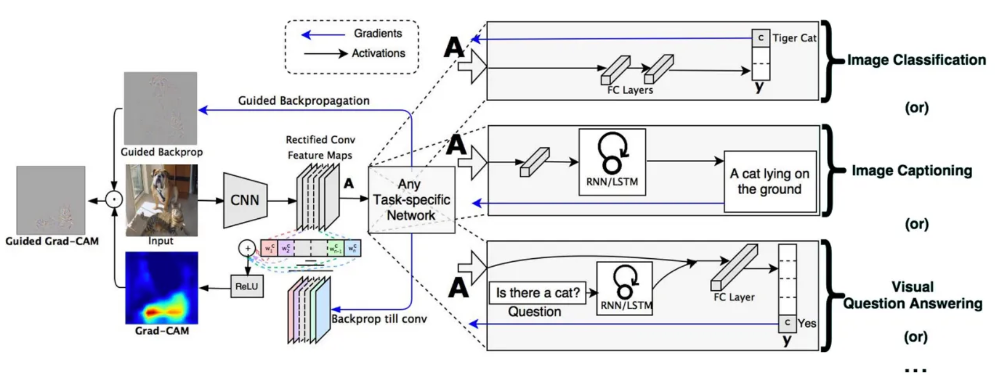
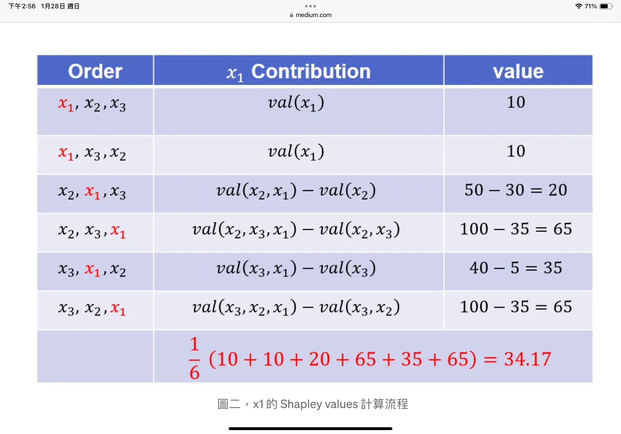
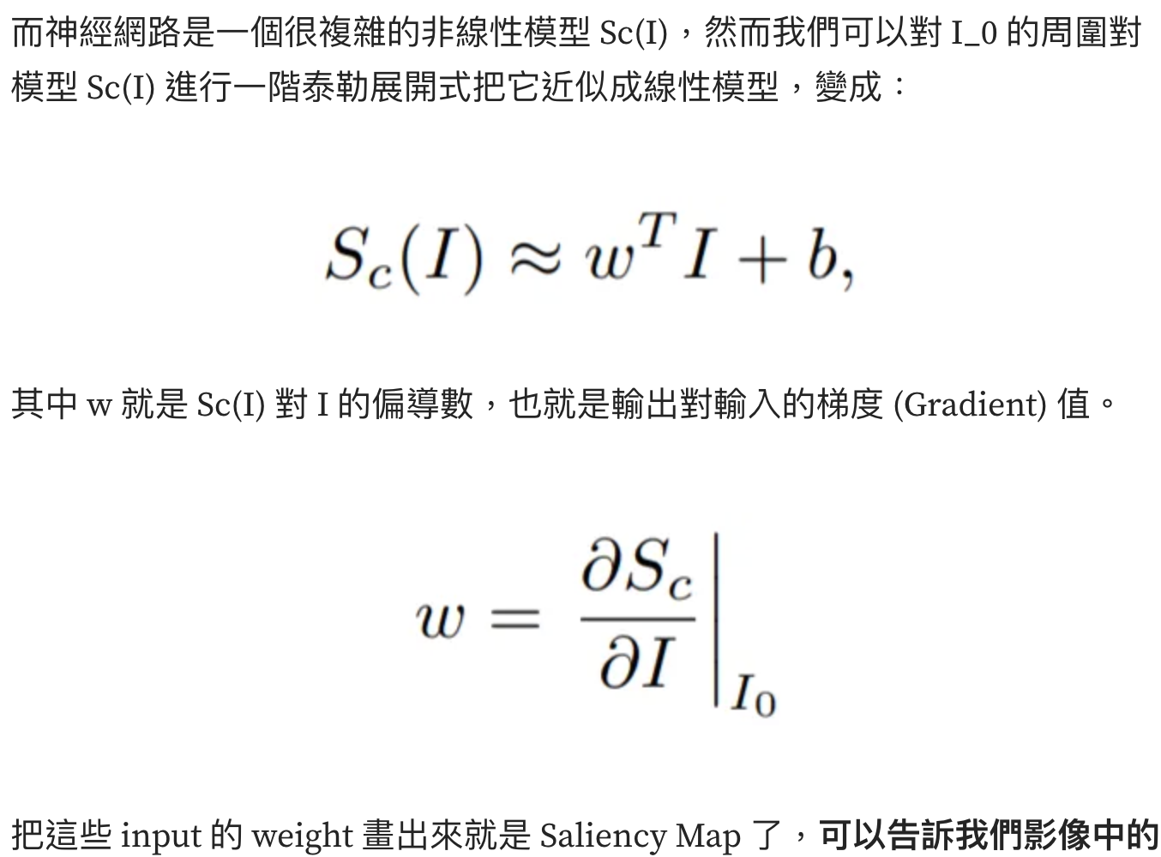
Method | Grad-CAM | LRP (Layer-wise Relevance Propagation) | TCAV (Testing with Concept Activation Vectors) | XGNN (Explainable Graph Neural Networks) | SHAP (Shapley values) | Integrated Gradients | Meaningful Perturbations | I-GOS (Integrated-Gradients Optimized Saliency)
Main concept | Calculate the weight used in CAM (Class Activation Mapping) by backpropagation and then passing through a ReLu | Layer by layer tracing back from prediction to the input finding out the important pixel of who | Using a simple classifier (CAV) to ensure that the model understands the correct concept: choose 1 focused concept -> Prepare 2 datasets our training dataset (a) and a random dataset containing concept (b)-> pre-trained by (a)的 main model convert (b) datasets to feature map -> CAV decide the understanding of the model to the concept | Train a generator (with rules set to be closer to the real data) doing reinforcement learning maximizing the prediction of the model, and the final graph generated by the generator is most representative. | Calculate Shap value for each feature (the contribution to prediction of each feature) | For gradient-base method, the importance of the feature can be calculated as F(x)/x_i (f(x) = model, x_i = feature_i), however, it’ll have gradient saturation problem, thus, the derivative function is replaced with integration function. | Find out the important features by masking / occluded map (blur, constant, noise) that lead to the maximum drop of the model’s prediction | ~ Integrated Gradients + Meaningful Perturbations: Using integrated gradients to optimize the mask of perturbation
Pros | Guided grad-CAM conserve big scale feature and detail | model-agnostic | Linking the man-used concept and the model understanding | Invented particularly for graph classification | Strong mathematical basic Consider the interaction between features | NN model ok | model-agnostic | NN model ok
Cons |  | Watch out for parameter tuning it may affect result | Making a new random dataset The unitary abstract concept difficult to represent Only for image | For GNN only Generator may stuck in one graph and ignore other possible crucial graphs | computational slowly (kernel SHAP can help a little) If sparse explanations are required, counterfactual explanations might be preferable. | Need the based–line observation (will significant effect result) Only for differentiable model by default, gradients are integrated along the shortest path between the baseline and the point of interest | Computational more than LRP Occlusion may cause data become artifacts (generative models is suggested to overcome this problem) | /
Supplement |  | + value: this pixel has contribution to predicting the correct result - value: negative effect to prediction |  |  |  |  |  | Khorram, S., Lawson, T., & Fuxin, L. (2021, April). iGOS++ integrated gradient optimized saliency by bilateral perturbations. In Proceedings of the Conference on Health, Inference, and Learning (pp. 174-182).
Occlusion sensitivity (concept is similar to meaningful perturbation)

Slide 4
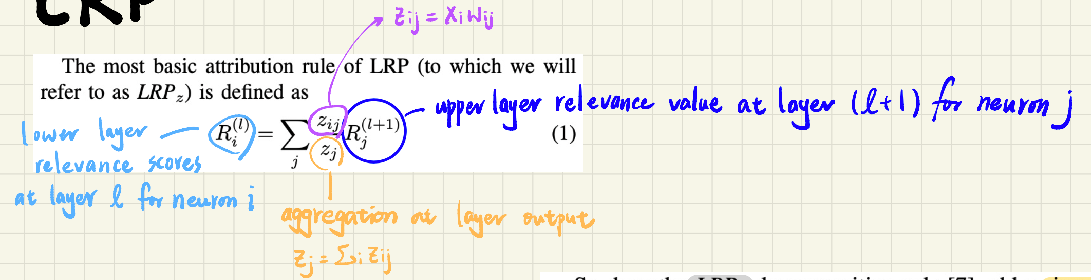
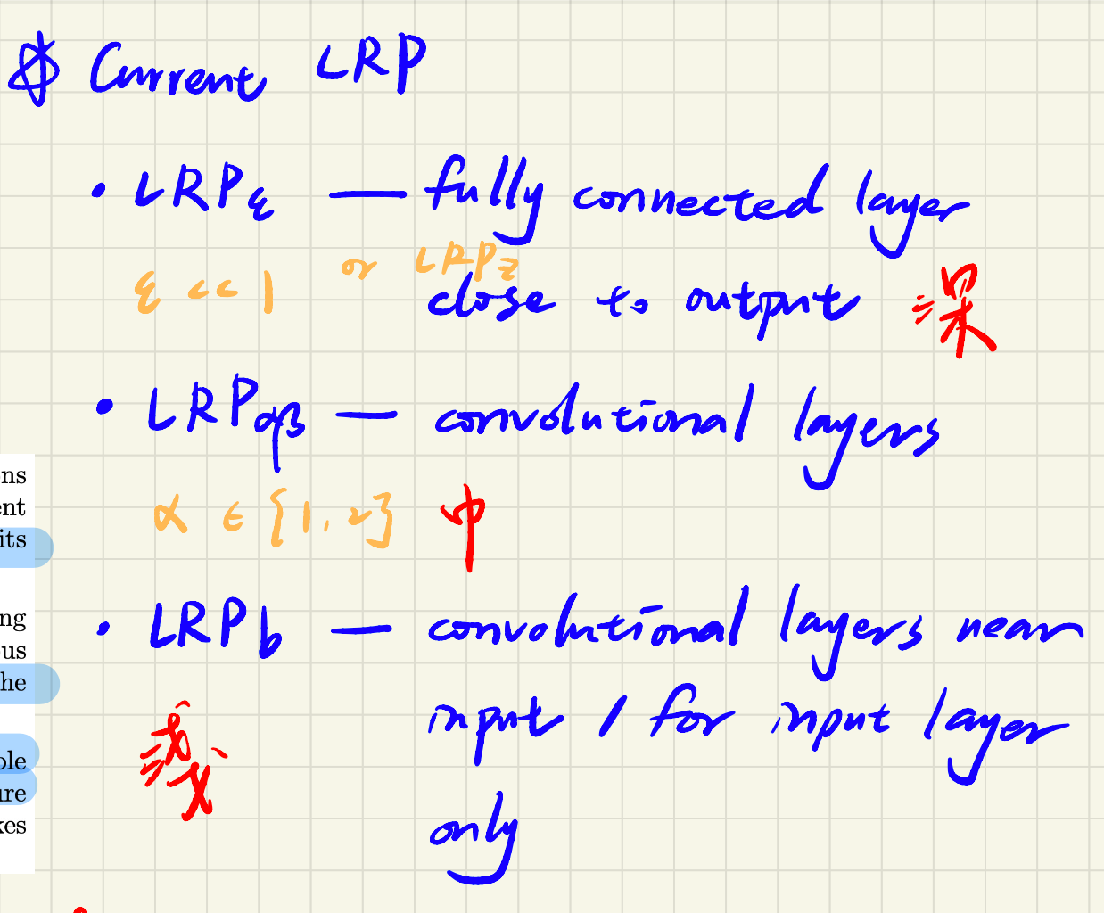
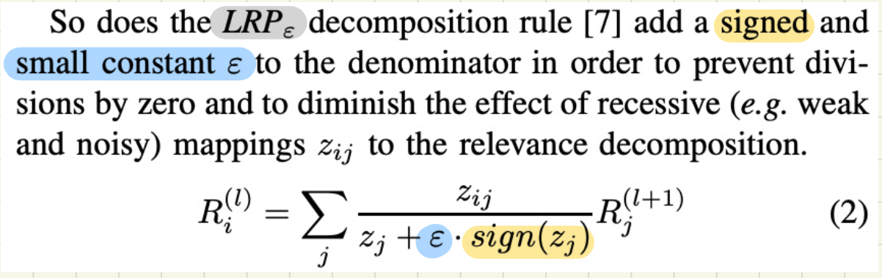
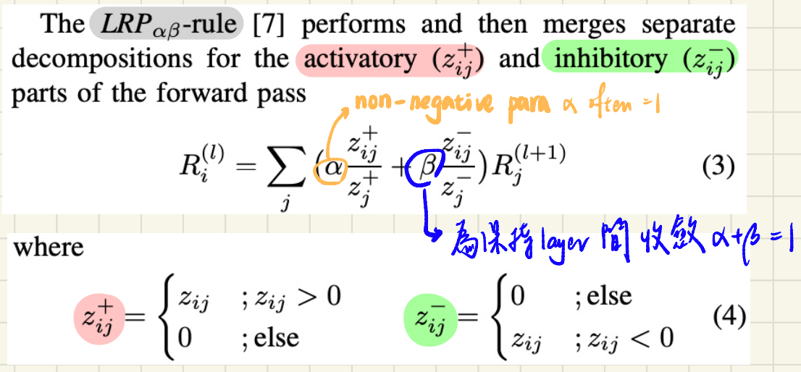
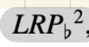
Basic - LRP_{Z}
Lower the impact of weak neurons - LRP_{epsilon}
Overcome gradient shattering - LRP_{alphabeta}
Propagate the relevance score of higher layer neurons for a more abstract concept explanation

Slide 5

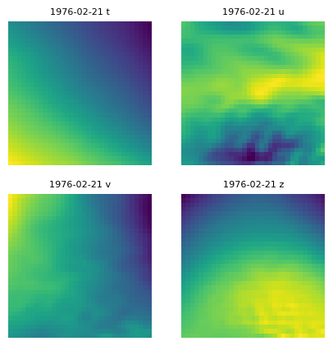
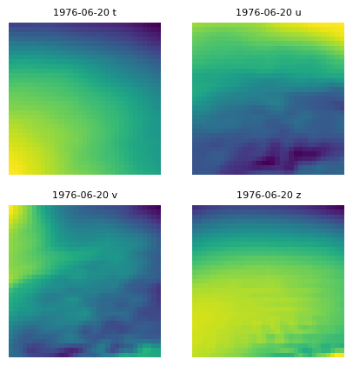
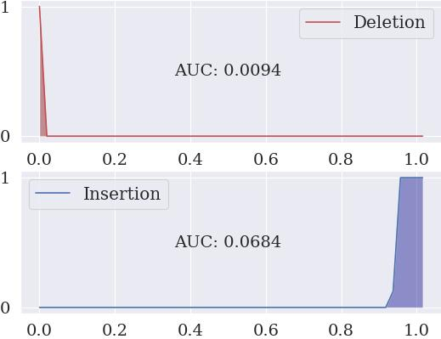
iGOS++
1624_('1976-02-21 08/00/00',)('1976-06-20 08/00/00',)_4M-pred4M

Slide 6
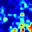
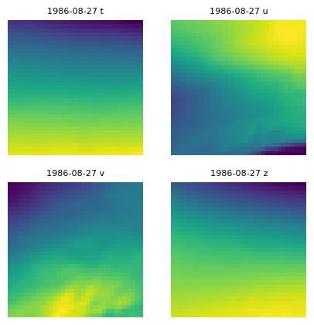
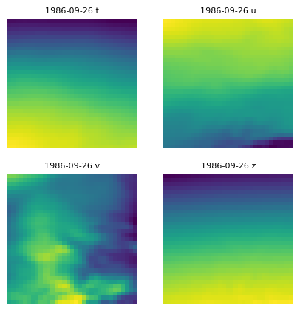
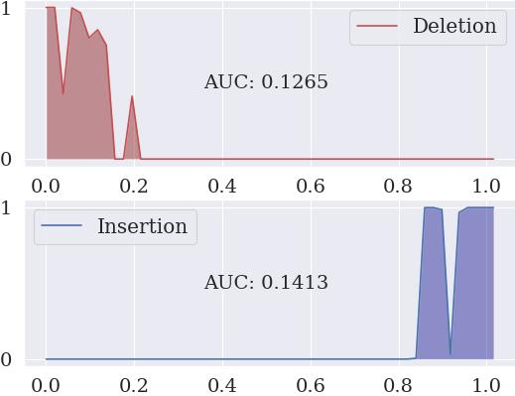
iGOS++
1611_('1986-08-27 08/00/00',)('1986-09-26 08/00/00',)_1M-pred1M

Slide 7
Critical points to use XAI
What’s the input? Their properties, format, preprocessing method etc.
What’s the task? The points that the model should be highly concerned with and the place our assumption should be made (what the model is supposed to see?)
= Make sure you know the point of view/mechanism of the XAI technique =
- Verify the assumption -
Data analysis for XAI output (statistical method)
Global: When it comes to this task, what’s the priority of the model or less concern or even the information is redundant? Any big trend in the model?
Local: What specific kinds of data will the model react the most? What’s its major?

Slide 8
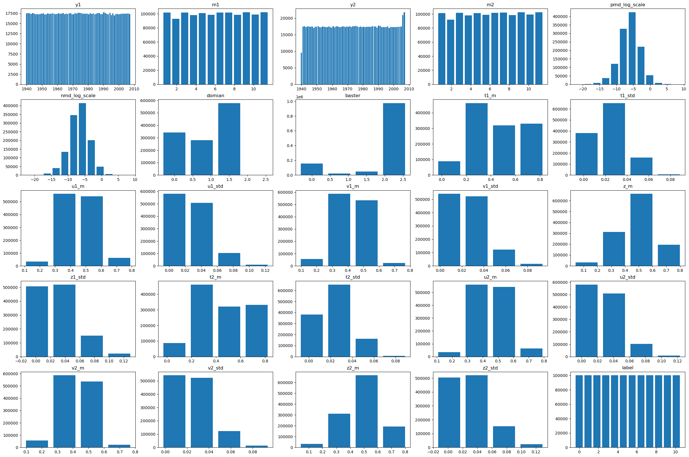
Big trend: Sample 1,200,000 of data points

Slide 9
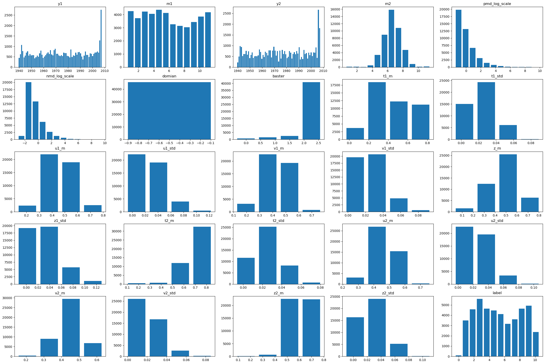
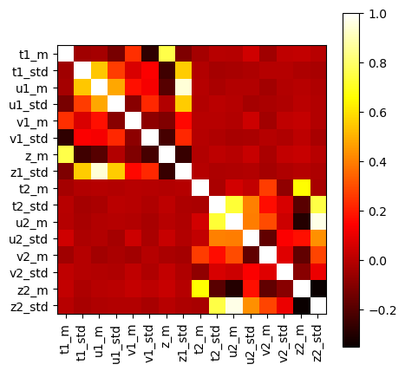
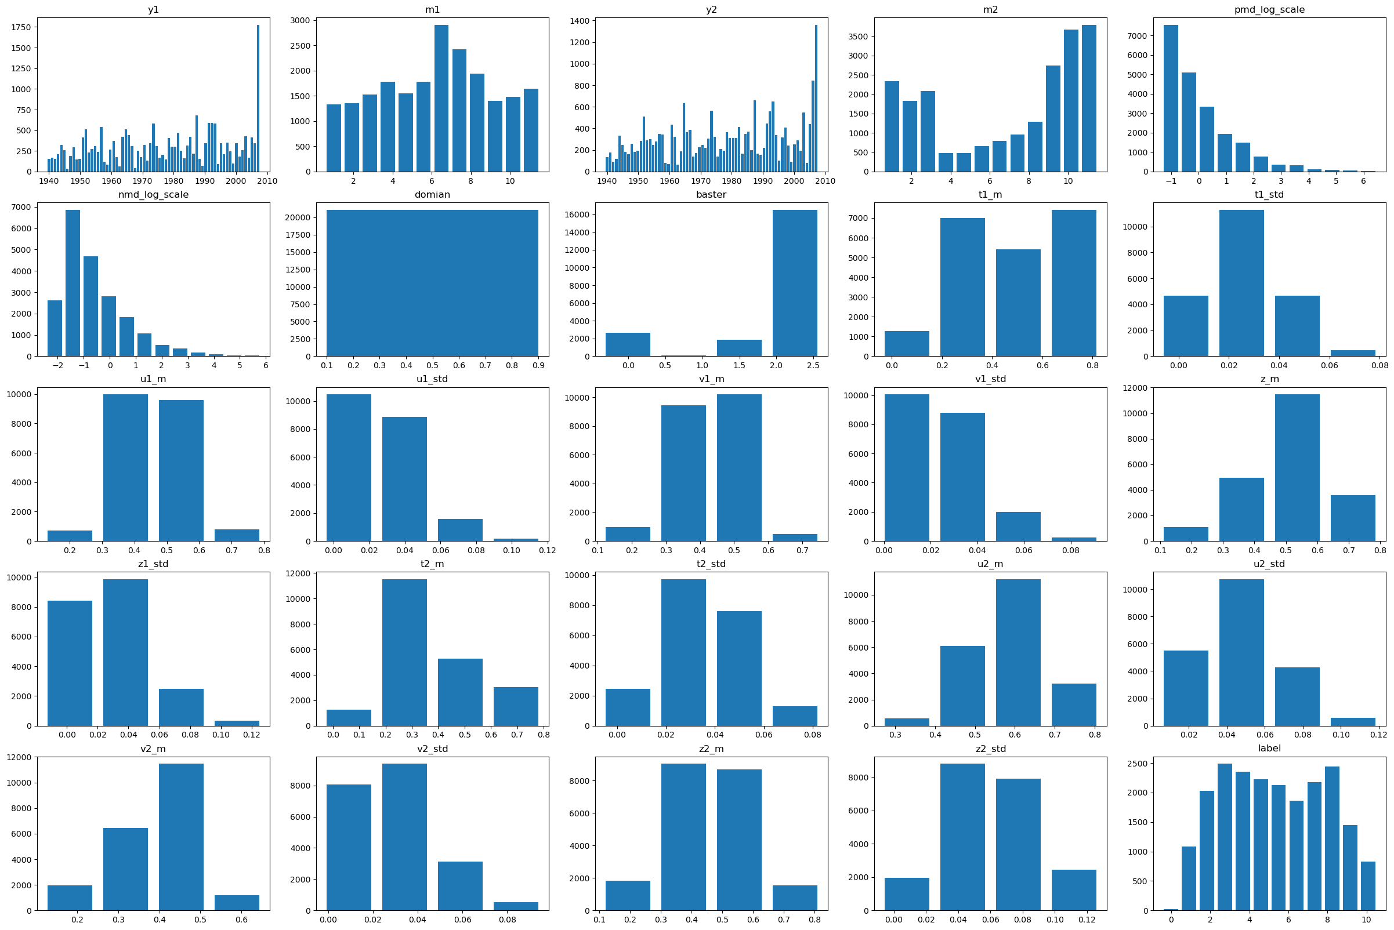
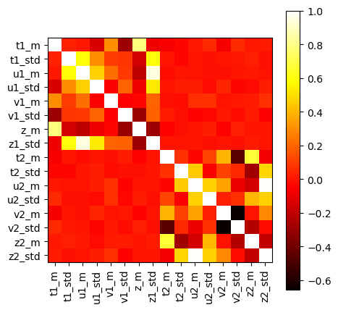
temperature
U component of wind

Slide 10
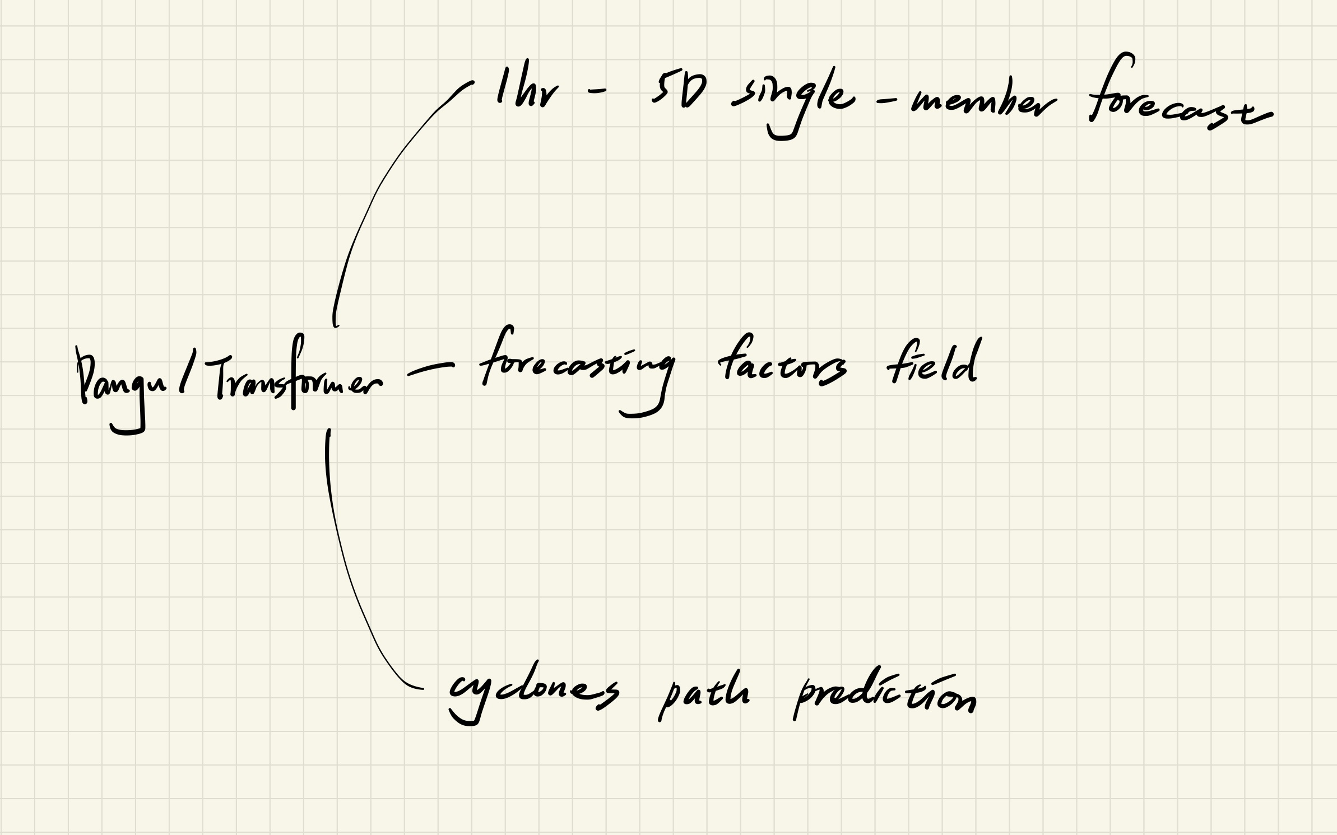
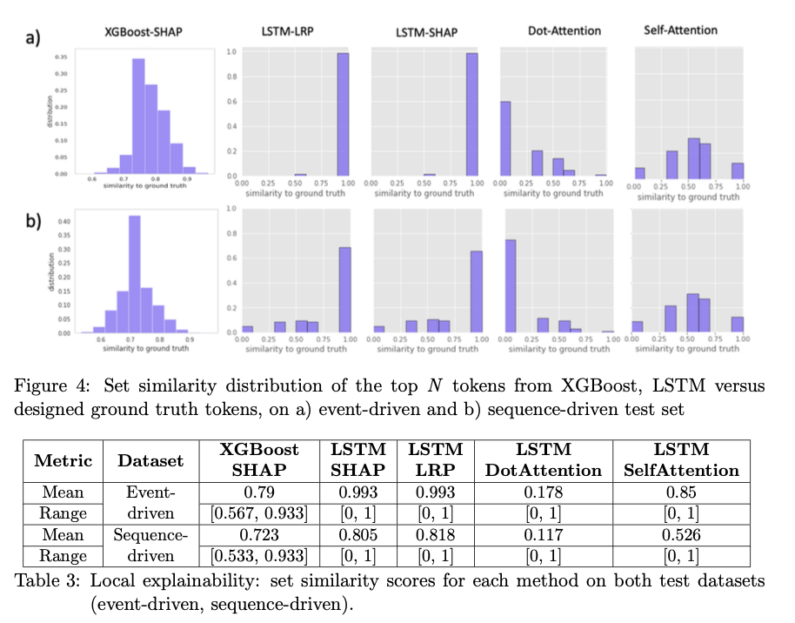
Next step
Only these tasks?/model?
For different task
Check up on their input and output
Make some assumptions
Global
Local
XAI verification

